Slide 1
Chapter 3 Relational Data Model
Presented by : Er. Lali Manandhar
Assistant Senior Lecturer
Everest Engineering College

Slide 2
Relational Model
Relational Model was proposed by E.F. Codd to model data in the form of relations or tables.
After designing the conceptual model of Database using ER diagram, we need to convert the conceptual model in the relational model.
The relational model of data is based on the concept of relation (table). Relational Model represents how data is stored in Relational Databases.
A relational database stores data in the form of relations (tables).

Slide 3
Relational Database Management System (RDBMS)
A relational database is a database structured in relational model.
A RDBMS is a collection of programs that can be used to create, maintain, modify and manipulate the relational database.
Some of the example of RDBMS are Oracle, MS-SQL Server , MS-Access etc.

Slide 4
Properties of RDBMS
Provides data to be stored in tables
Persists data in the form of rows and columns
Provides facility primary key, to uniquely identify the rows
Creates indexes for quicker data retrieval
Provides a virtual table creation in which sensitive data can be stored and simplified query can be applied.(views)
Sharing a common column in two or more tables(primary key and foreign key)
Provides multi user accessibility that can be controlled by individual users.

Slide 5
Advantages of Relational Model
It is very easy to use data are stored in the form of rows and column which is easy to perceive.
It is a very flexible approach.
It is secured. We can keep the sensitive attributes in separate relation with its own authorization control.
Data independence is another feature of this approach.
The query based on relational algebra for accessing the data is easy

Slide 6
Disadvantages of Relational Model
If the numbers of tables between which relationship is to be established are large and voluminous, the performance in responding to queries slows down.

Slide 7
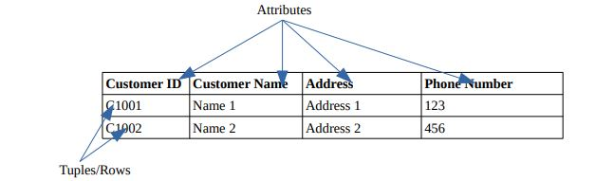
Structure of Relational Model
A relational database consists of collections of tables, each of which is assigned a unique name.
A row in a table represents a relationship among a set of values. A table is a collection of such relationships.

Slide 8
The above table consists of below listed components according to relational model.
Domain: A set of permitted values for an attributes.
Tuple: A record/row in a table is called tuple. Every relation is made up of many tuples.
Relation: The term relation in this model refers to the two-dimensional table of data.
Relation Schema: A relation schema consists of a list of attributes and their corresponding domains.
Relation instance: The relation instance is the collection of data at any instance of time within a relation.

Slide 9
Q. Why a database is called as relational database model?
A database model represents the relationship between one or more databases.
The relationship is known as the relational database model.
It is an extension of the normal databases without relations.
It provides flexibility and allows one database to be in relation with another database.
It can access the data from many databases at one time over the network

Slide 10
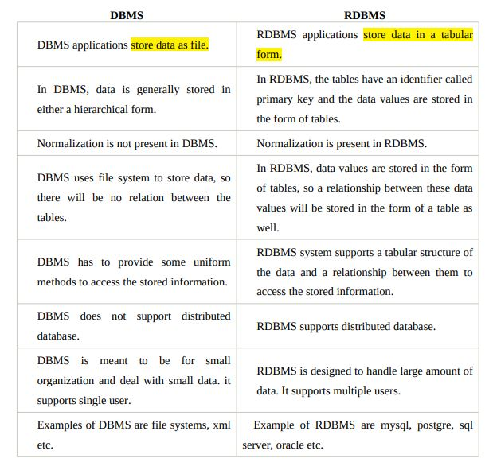

Slide 11
Kinds of Relation (Table)
Basically there are three types of relations. These are
Base tables A table that physically exist in the database with unique name. It can be created, altered and manipulated using SQL statement.
Query Result table: A table that is displayed to the user for showing the resultant data obtained when a ‘question’ is asked to a table.
Views: A view is a virtual table which consists of only those columns from base table that the database user wants to see.

Slide 12
Relational Algebra
The relational algebra is a procedural language which consists of set of operations that take one or two relations as input and produce a new relation as a result.
Relation algebra can be viewed as data manipulation language for relation model.

Slide 13
The fundamental operations in relation algebra are
1. Select
2. Project
3. Union
4. Set Difference
5. Rename
6. Cartesian product.
More three operations have been defined in term of these six, they are
1. Set Intersection
2. Joins
3. Division.

Slide 14
1. Selection Operator
Selection operator is unary operator.
The selection operator is sigma: σ
The selection operator acts like filter on a relation by returning only a certain numbers of tuples.
The resulting relation will have the same degree as the original relation. However the number of tuples is less than that of original relation.
σC(R) returns all those tuple in relation R that satisfy the condition C.
A condition C can be made up of any combination of comparison or logical operator that operates on the attribute of R.
Comparison operators: = , , ≥, ≤, ≠ Logical operators: ¬, ˄, ˅ : (not, and , or ) repspectively

Slide 15
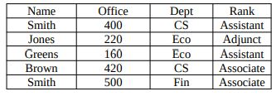

Example: Assume the following relation tbl_employee has the following attributes and tuples.
1. Select those employees in the CS department.

Slide 16
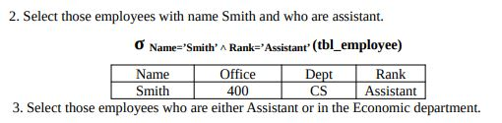
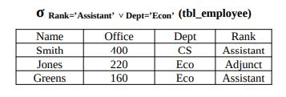

Slide 17
2. Projection Operator
Projection is also a unary operator. The projection operator is pi: ∏.
Projection limits the attributes that will be returned from the original relation.
The general syntax is ∏attribute(R) where attribute is the list of attributes to be displayed from the original relation R.
The resulting relation have the same number of tuples as the original relation however the degree of the resulting relation may be equal to or less than that of the original relation.

Slide 18
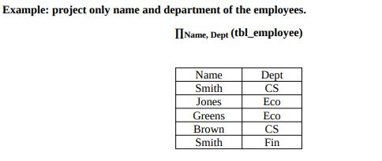

Slide 19
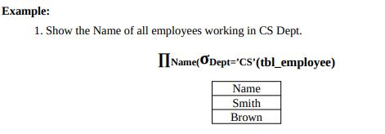
Combining Selection and projection
The selection and projection operators can be combined to perform both operation i.e. display selected tuples with selected attributes.

Slide 20
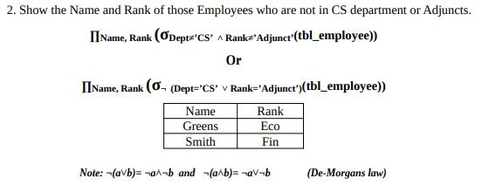

Slide 21
3. Union
The union operation on two relations R and S denoted by R U S having same number of attributes results a new relation having records from both relation with duplicate records removed.

Slide 22
4. Set Difference
The difference operation on two relations R and S denoted by R-S results a relation containing those records from R but not from S.

Slide 23
5. Intersection
The intersection operation on two relations R and S denoted by R∩S results a relation with records that appears in both R and S.

Slide 24
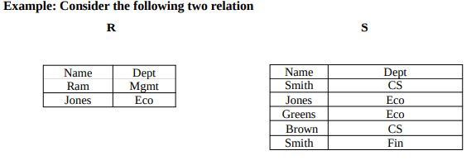

Slide 25
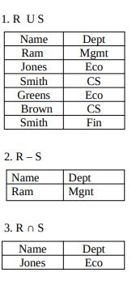

Slide 26
6. Rename Operator (ϱ))
The rename operation on and existing relations results a relation under a new name.
is the relation with B with its name changed to A.

Slide 27
7. Cartesian Product
The Cartesian product also called as cross product or cross join is used to produce all combination of records from two relations i.e. it combines the record on one relation with all the records from another relation.
If R and S are two relation having n and m number of attributes and p and q number of records respectively , then the Cartesian product of these two relation denoted by R X S results a new relation having (n+m) number of attributes and (p*q) number of records.

Slide 28
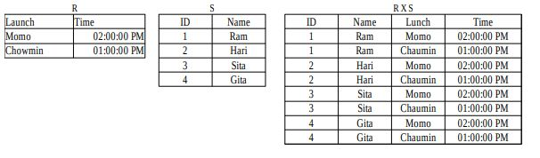

Slide 29
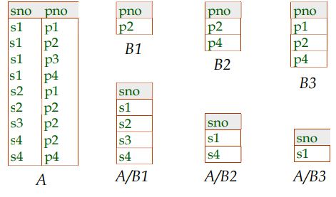
8. Division
The divide operator takes two relations and builds another relation consisting of values of an attribute of one relation that matches all the values in another relation.

Slide 30
9. Joins
Joins operation bring together two relations and combine their attributes and tables in a specific fashion.
Join is a combination of a Cartesian product followed by a selection process.
In its simplest form, the join operation is just the cross product of two relations which produce large result size but using this operation, one record from relation R and one record from Relation S can be combined together to form the result if the combination satisfies the join condition.
The join condition can be =, , ≤, ≥, ≠

Slide 31
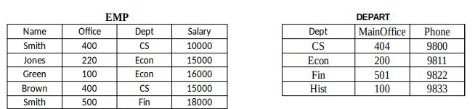
A. Equijoin
A join when the join condition is = then we call it Equi-join.
Example: Assume we have two relations EMP and DEPART as below.

Slide 32
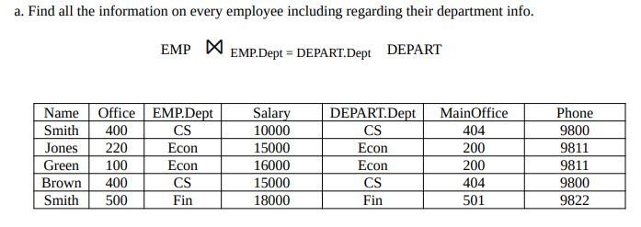
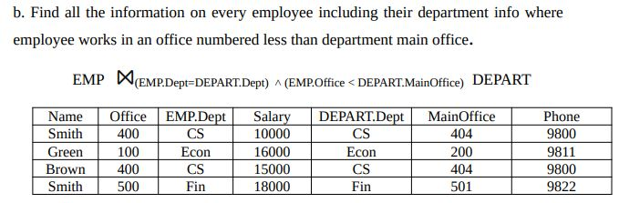

Slide 33
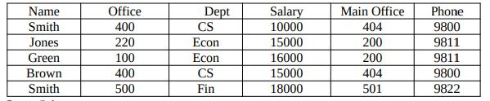
B. Natural Join ⋈
In Equi-join, any attributes in common such as DEPT in above relations are repeated. The natural join will remove such duplicate attributes. Natural join does not use any comparison operator.
Example: EMP ⋈ DEPART

Slide 34
C. Outer Join
The outer join is an extension of the inner join.
Outer joins of two or more tables perform an inner join of those tables according to a specified join condition and also return rows from the left join table, the right join table, or both, that do not match the inner join condition, extending the results rows with nulls in the non matching fields.

Slide 35
i. Left Outer Join :
It includes all tuples from left hand relation and include only those matching tuples from right hand relation.
ii. Right Outer Join
It includes all tuples from right hand relation and include only those matching tuples from left hand relation.
iii. Full Outer Join
It includes all tuples from both left hand relation and right hand relation.

Slide 36
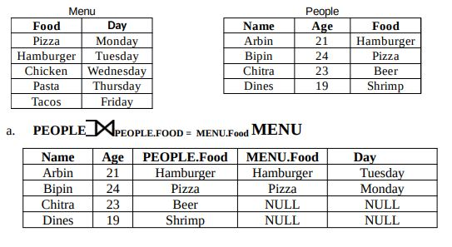
Examples: Assume we have two relations PEOPLE and MENU

Slide 37
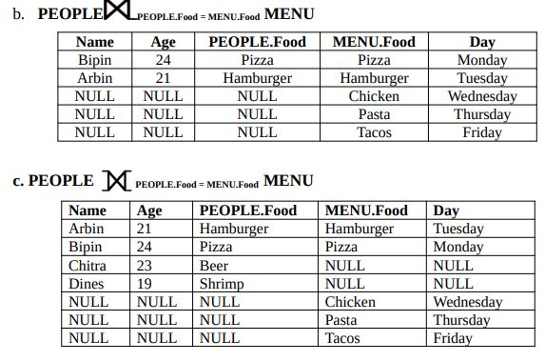

Slide 38
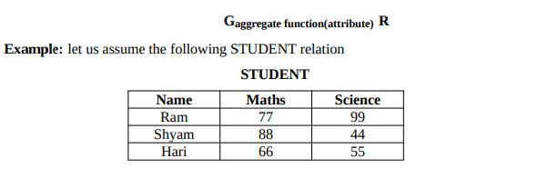
10. Aggregate Function
The aggregate functions summarizes the values for a column.
There are five aggregate function which are sum(), avg(), count(), min(), and max().
In relational algebra the aggregate function are written as below

Slide 39
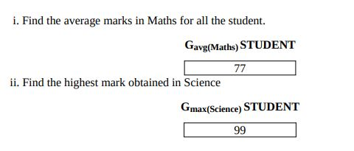
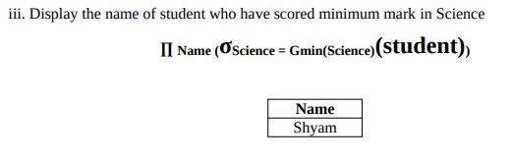

Slide 40
Modification of database using relational algebra
The content of database can be modified by using the following operations
1. Deletion:
A delete request is expressed similarly to a query, except that instead of displaying tuples to the user, it remove the selected tuples from database.
A delete operation deletes the whole tuple not a value of particular attribute/column.
A deletion is expressed in relational algebra by where r is a relation and E is a relational algebra query

Slide 41


2. Insertion
In relation algebra, an insertion is expressed by
where r is a relation and E is a relational algebra expression.

Slide 42
3. Updating
An updating is expressed in relational algebra by
r ∏f1, f2, f3----(r)
In the above relational algebra, Each fi is the ith attribute of r.
Example: Pay all accounts with balances over $10,000 6 % interest
←

Slide 43
View
Any relation that is not part of the logical model but it is made visible to user as a virtual relation is called view.
A view is a virtual table i.e. a view looks like a table and acts like a table as far as a user is concerned.
View doesn’t require physical storage.

Slide 44
Advantages
View can be used to create logical column.
View can be used to maintain the summarized data by using various aggregate functions.
Complexity can be avoided
View can join multiple tables and display into a single virtual table.

Slide 45
View can be classified into two types
1. Simple View: I f the view is created from a single table, it is called a simple view.
2. Complex View: If the view is created on multiple table, it is called complex view.
The Syntax for creating view is
Create view <View Name>as<Query Expression>
Q. Create View for Displaying all the records.

Slide 46
Assignment
Define Constraints in Relational Model and Key Integrity. What is referential Integrity?
Write the difference between Relational Algebra and Relational Calculus.
How inner join different from outer join? Point out the differences.
How Relational Algebra is different from Relational Calculus? Define TRC and DRC.

Slide 47
Class work of relational algebra

